Slide 1

Engineering Technology & Design Project
Group 1 Members:

Slide 2
We have designed the project with the following requirements:
This circuit is controlled by Program (Anaconda Python 3.6) and LabJack Automation device
The software and user will be able to change the motor's direction
The software and user will be able to change the motor's speed

Slide 3
Hardware Requirements:
12-DCV Motor (1)
Resistor 220 ohm (2)
Resistor 10Kohm (6)
4N25 Optical Isolator (2)
L293D IC Chip (1)

Slide 4
Software Requirements:
Anaconda Python 3.6
Spyder
Labjack 2018
KICAD
Microsoft Powerpoint

Slide 5
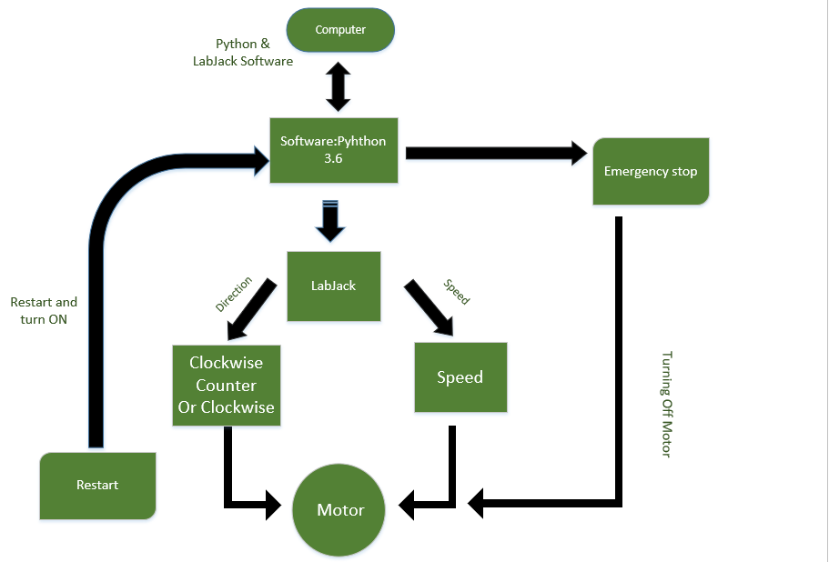
Block Diagram

Slide 6
Circuit Description
According to our course level, there are two approaches to create the circuit.
1 - Using level shifters, which use a logic inverter to modify the voltage level.
2-For heavy loads, integrated circuit (IC) drivers can also be used.

Slide 7
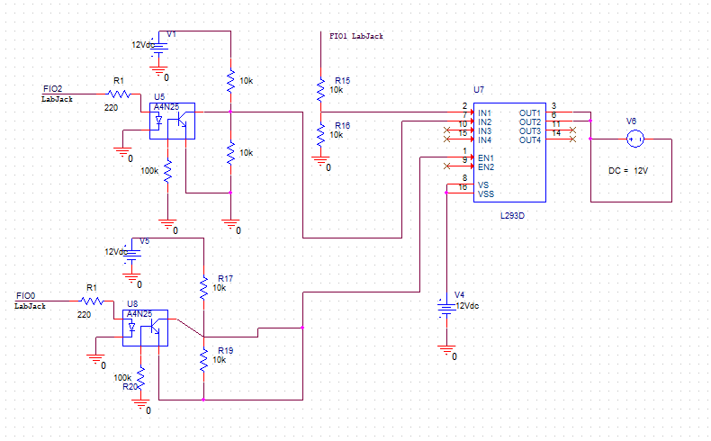
Orcad simulation with IC

Slide 8
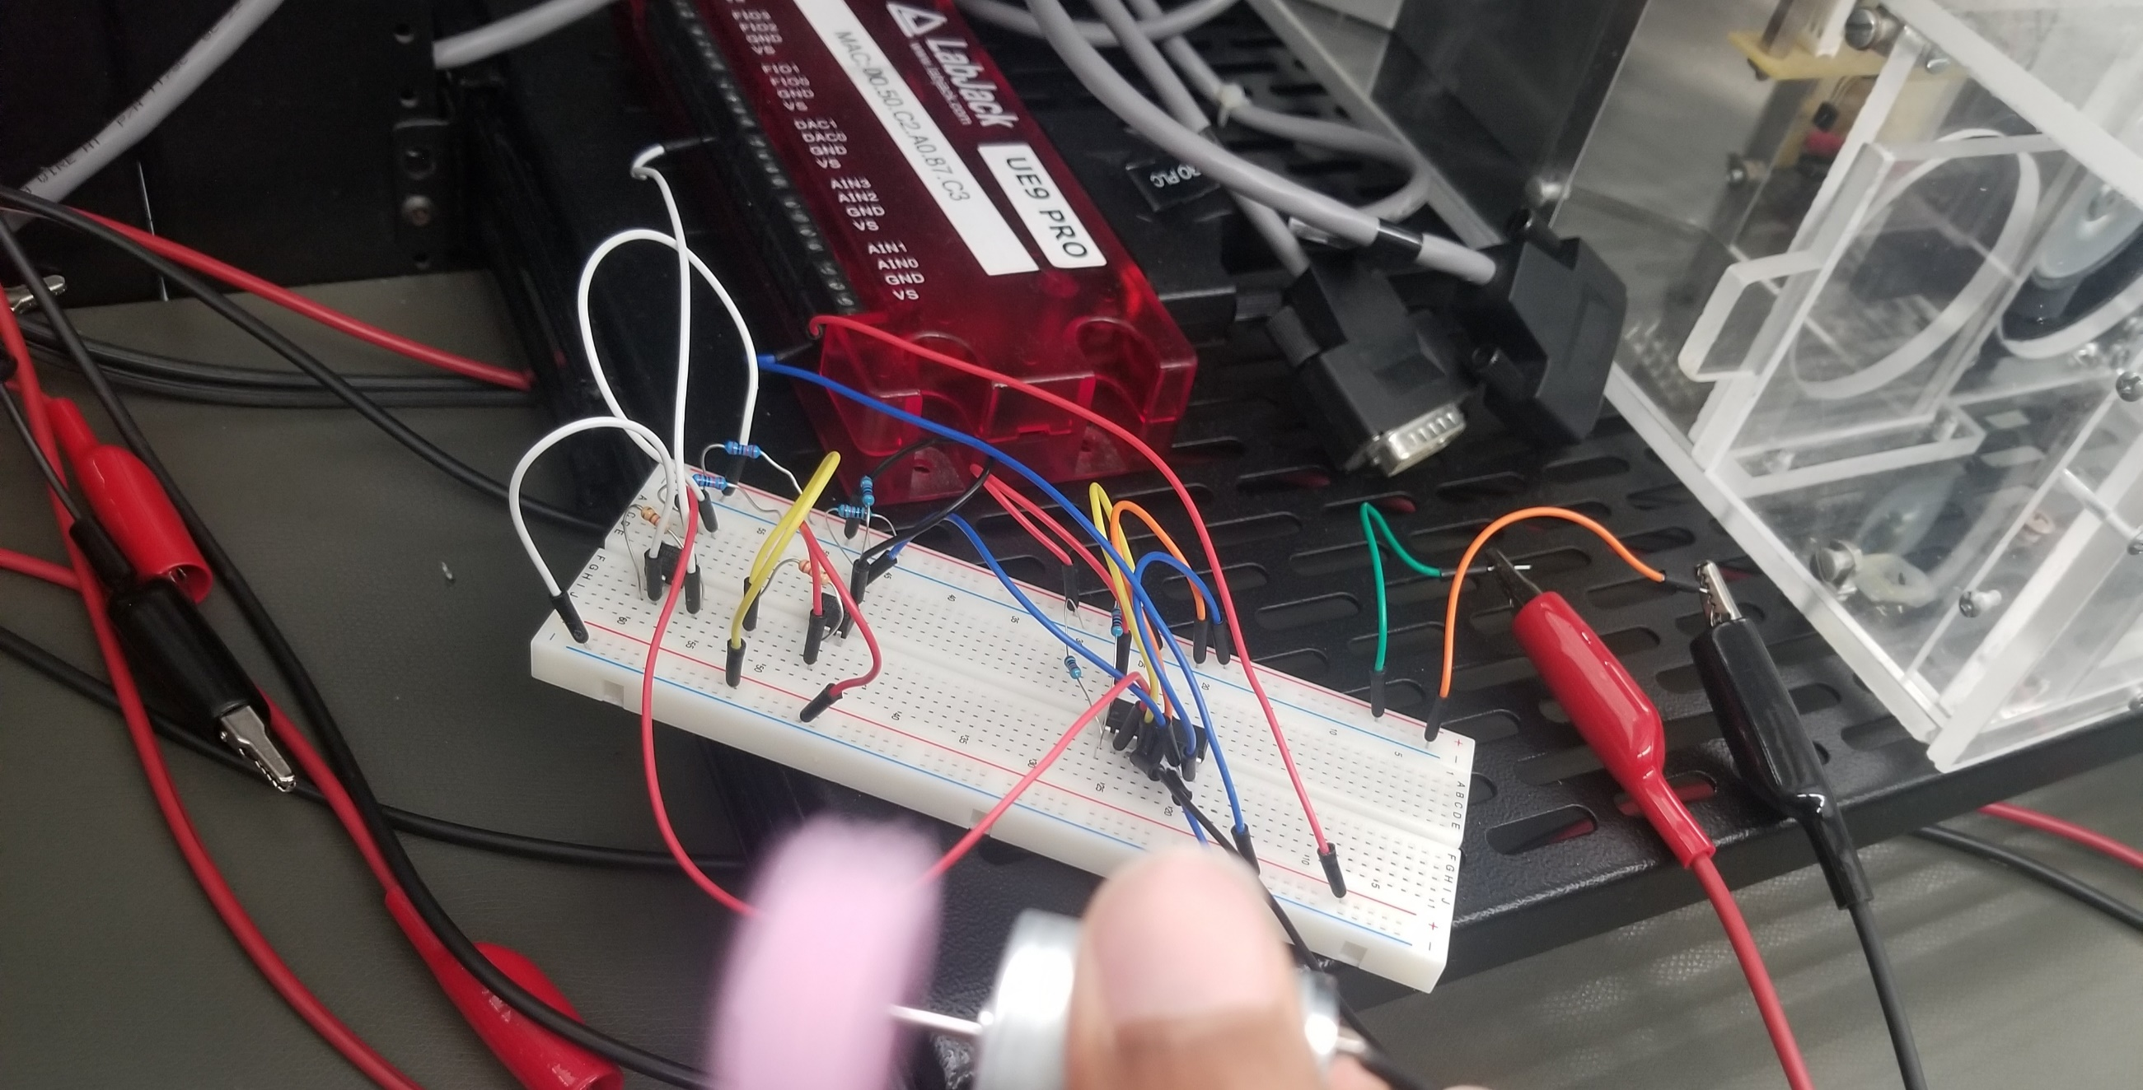

Slide 9
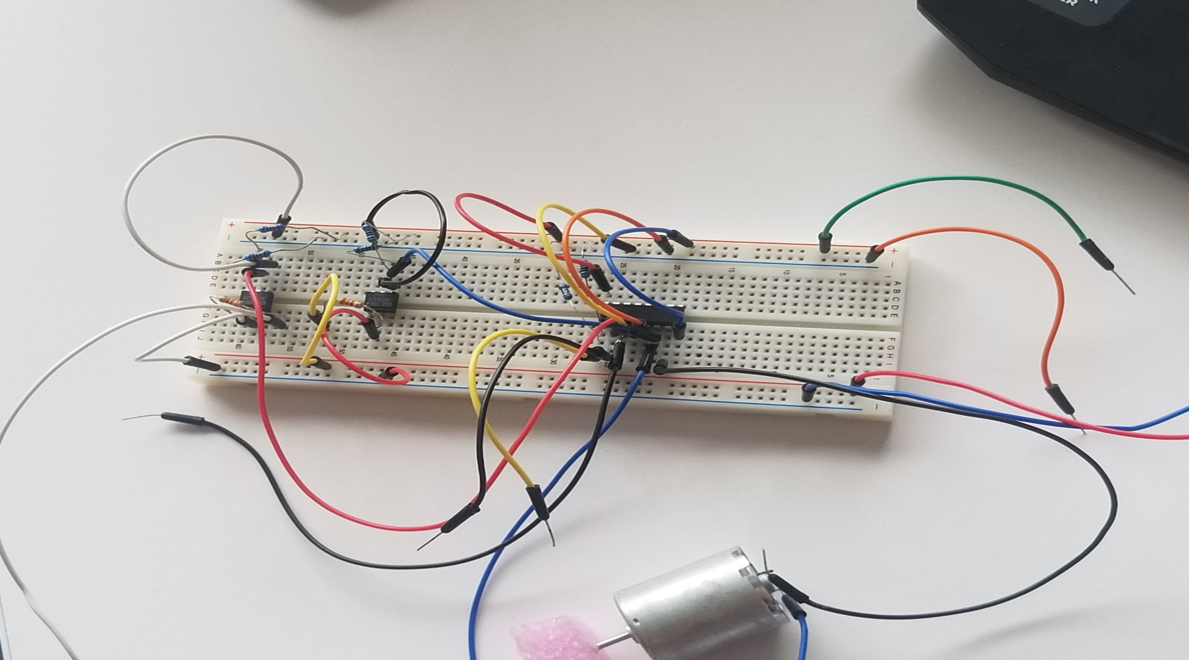

Slide 10
Python Programming
import ue9
import LabJackPython
myUE9 = ue9.UE9(ethernet=True, ipAddress="10.32.110.26")
myUE9.timerCounter(TimerClockBase=1, TimerClockDivisor=4, Timer0Mode=0, NumTimersEnabled=1, UpdateConfig=1, Timer0Value=1)
fio0_mask = 0b1111
fio1_mask = 0b1111
fio0_dir = 0b0000
fio1_dir = 0b1111
fio0_state = 0b1111
Fio1_state = 0b0000
results = myUE9.feedback(FIOMask=fio0_mask, FIODir=fio0_dir, FIOState=fio0_state)
results = myUE9.feedback(FIOMask=fio1_mask, FIODir=fio1_dir, FIOState=fio1_state)

Slide 11
Problems faced during the project
Difficulties : Solutions:
In communications and meeting WhatsApp and meetings in campus for 2 hours.
Build the PCB Prototype Build in Breadboards to make sure it’s functioning.
Testing the circuit Going to open lab to test the circuit using the power supplies provided there
Python Software Using lab 9 content, remembered concepts from other previous subjects.

Slide 12
Conclusion
Controlling Speed – by varying potential deference using Labjack UE9
Changing the Direction – Reversing Polarity using Labjack UE9

